Slide 1
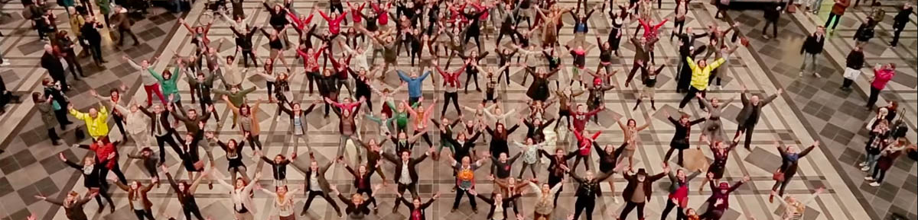

RAPIDO
Reversal Agents in Patients antIcoagulated with Direct Oral anticoagulants

Slide 2

Why get involved?
Being part of something bigger
Answering important clinical questions
Citable collaborator status
Notes:
Can be a catastrophic event

Slide 3
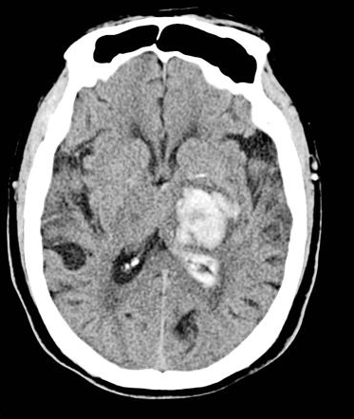
DOAC-related bleeding
1-2% risk per year
ICH mortality 30-40%
Notes:
Can be a catastrophic event

Slide 4
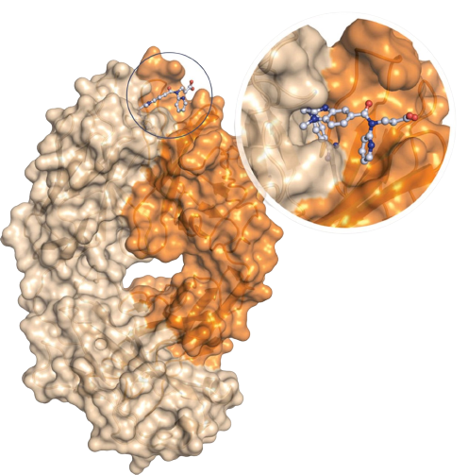
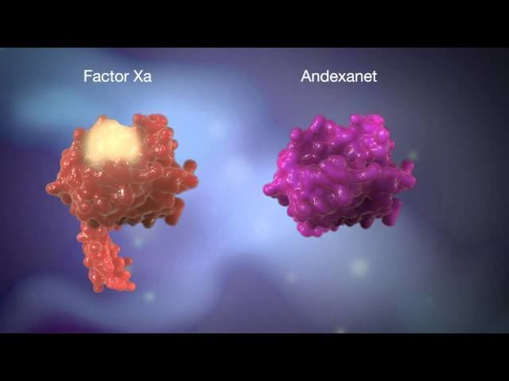
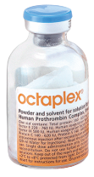
Reversal agents
Andexanet alfa
PCC
Idarucizumab

Slide 5

RAPIDO
Primary outcome (audit standards)
  Reversal agents should be used for severe or life-threatening bleeding
Secondary outcomes (hypothesis generation)
  Death within 90 days
  Thrombosis within 90 days
@HaemSTAR_UK

Slide 6
RAPIDO
Primary outcome (audit standards)
  Reversal agents should be used for severe or life-threatening bleeding
Secondary outcomes (hypothesis generation)
  Death within 90 days
  Thrombosis within 90 days
@HaemSTAR_UK

Slide 7
RAPIDO
Inclusion criteria
  Any adult
  Reversal agent for DOAC-associated bleeding
  1st October 2020 to 30th June 2023
@HaemSTAR_UK

Slide 8
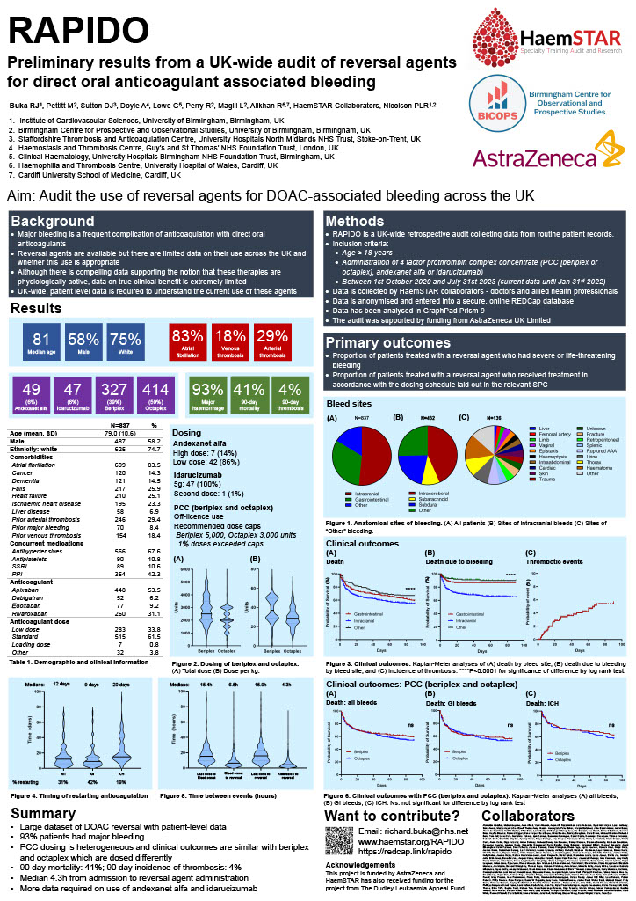
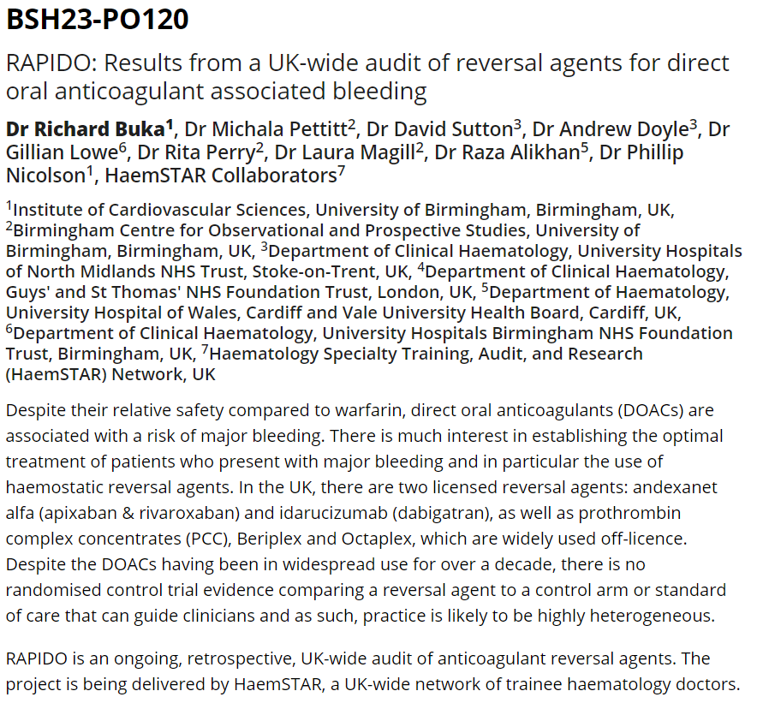
RAPIDO: Interim Results
@HaemSTAR_UK

Slide 9
RAPIDO: Interim Results
Participation
  >200 collaborators
  38 hospitals
  837 patients
Patient demographics
  Median age 81 (IQR 73-87)
  84% AF
Primary outcome
  93% had major bleeding
@HaemSTAR_UK

Slide 10
RAPIDO: Interim Results
Participation
  >200 collaborators
  38 hospitals
  837 patients
Patient demographics
  Median age 81 (IQR 73-87)
  84% AF
Primary outcome
  93% had major bleeding
@HaemSTAR_UK

Slide 11
RAPIDO: Interim Results
Participation
  >200 collaborators
  38 hospitals
  837 patients
Patient demographics
  Median age 81 (IQR 73-87)
  84% AF
Primary outcome
  93% had major bleeding
@HaemSTAR_UK

Slide 12
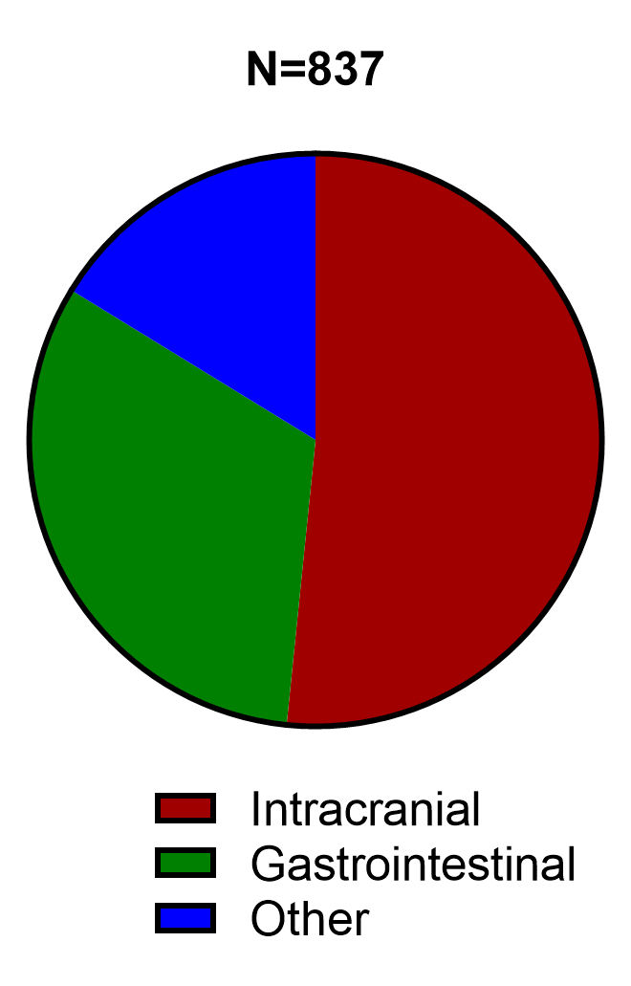
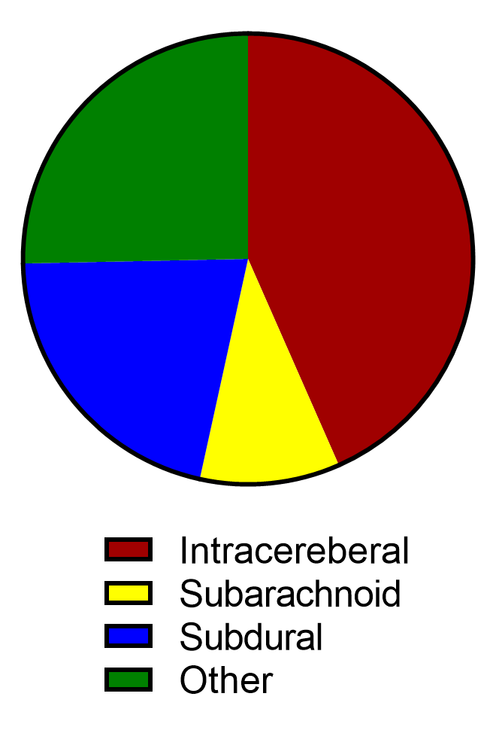
RAPIDO: Interim Results
All bleeds (n=837)
Intracranial bleeds
Reversal agent
@HaemSTAR_UK

Slide 13
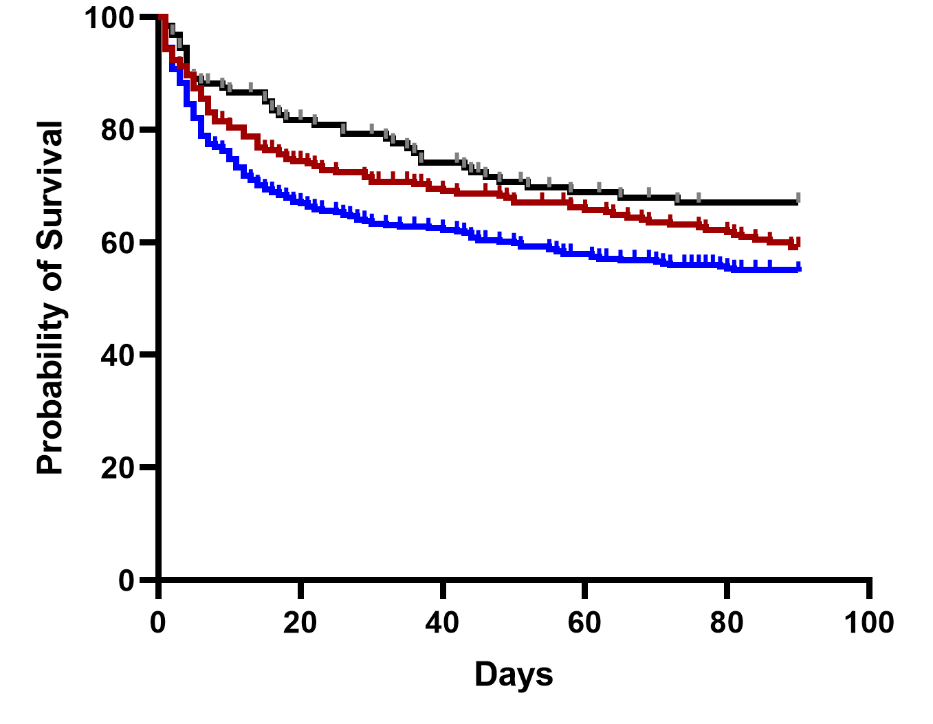
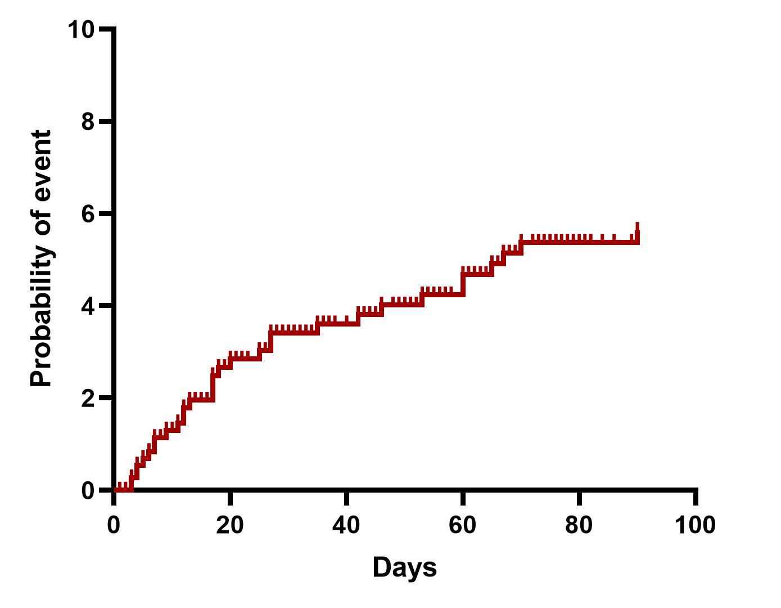
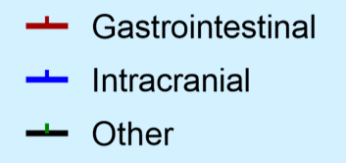
RAPIDO: Interim Results
Survival
Thrombotic events
****

Slide 14
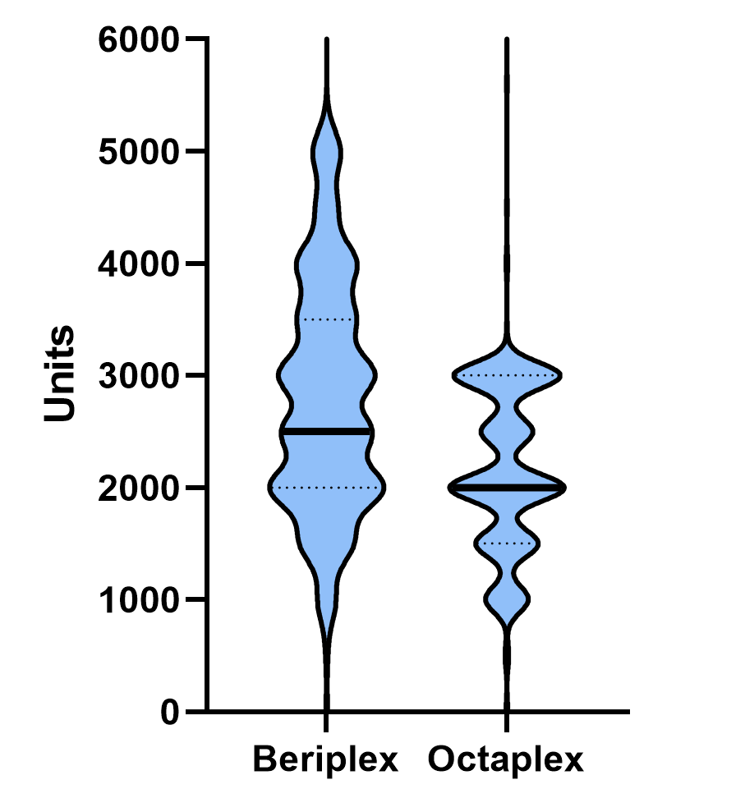
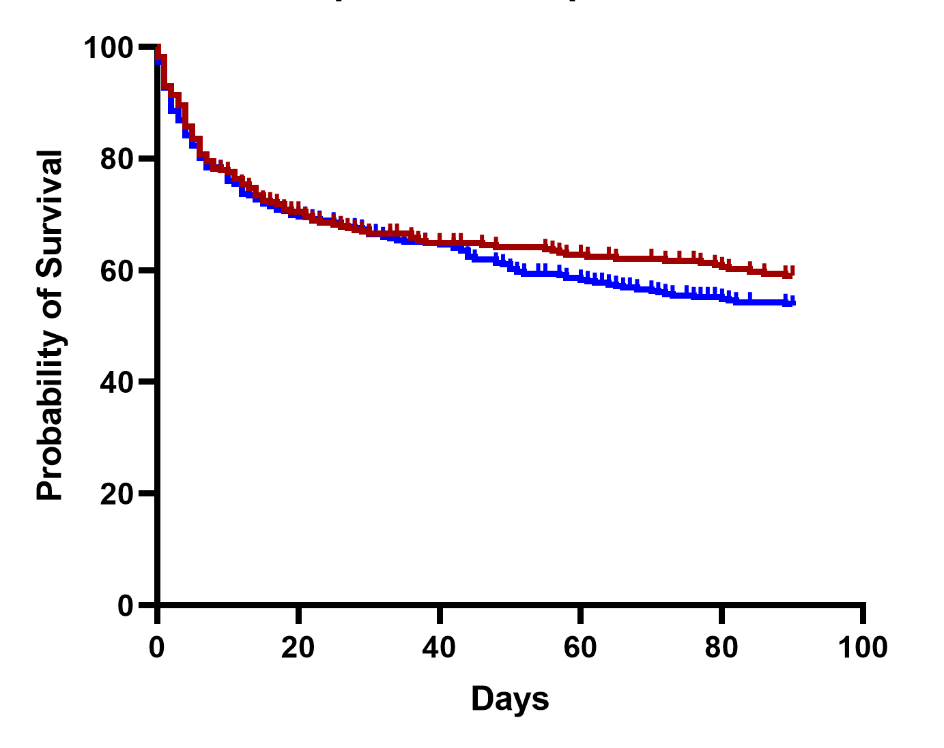
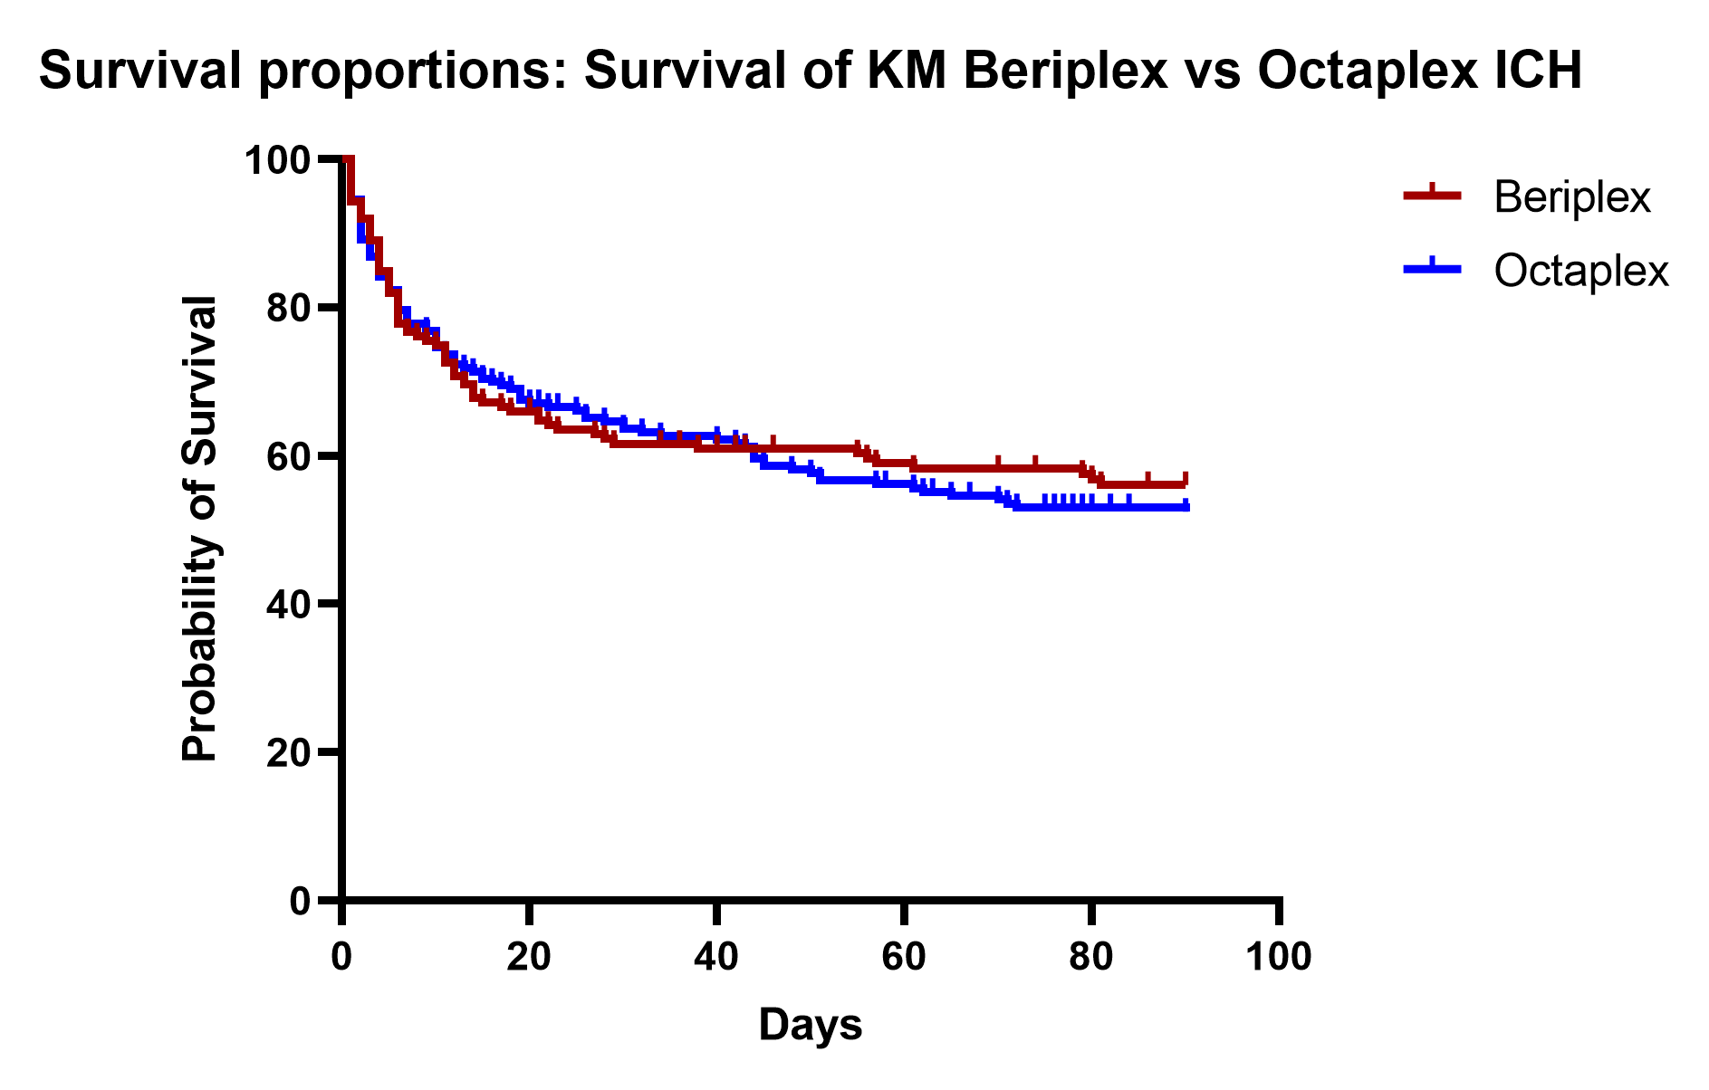
RAPIDO: Interim results
PCC dosing
PCC dose
Survival: all bleeds
ns
Clinical outcomes: PCC (beriplex and octaplex)
(B)
Death: GI bleeds
ns
Notes:
PCC usually dosed according to weight
Dose cap for beriplex on SPC is 5,000 units whereas octaplex is 3,000 units
Therefore mean beriplex dose significantly higher than that of octaplex.
Allows us to compare patients receiving high versus low dose PCC
Survival difference is not significant suggesting that lower dose is adequate

Slide 15
What do I do now?
  Find out if your centre is signed-up
    Email richard.buka@nhs.net
  If signed-up, liaise with lead for first data collection window
  If not signed-up:
    Register audit with the trust (www.haemstar.org/rapido for copy and pastable materials)
    Generate a list of patients from pharmacy and/or blood bank
    Gather a team together
    Complete the centre sign-up form: https://bistc.redcap.bham.ac.uk/surveys/?s=YTAELP7CHE
@HaemSTAR_UK

Slide 16
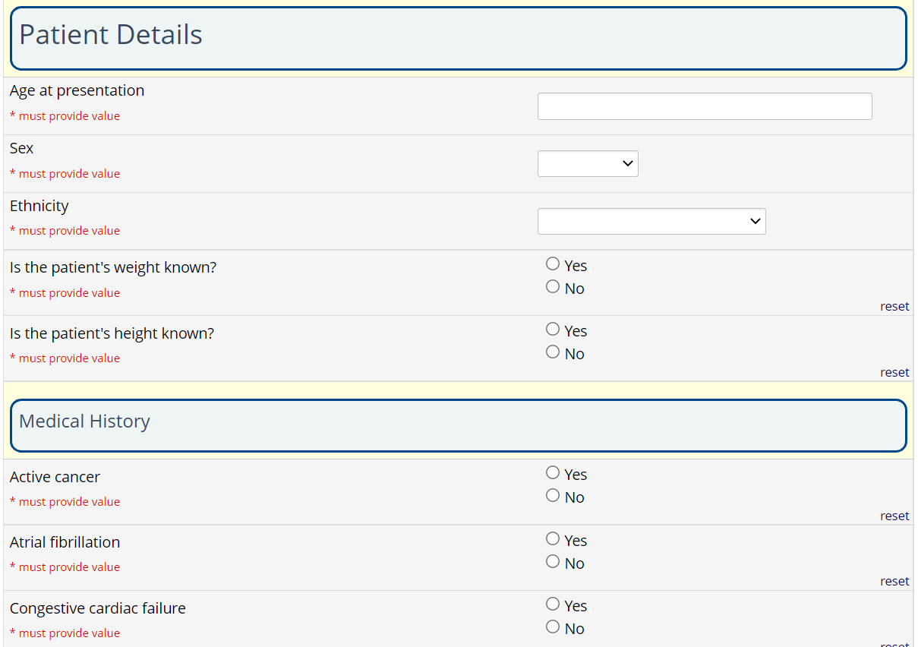
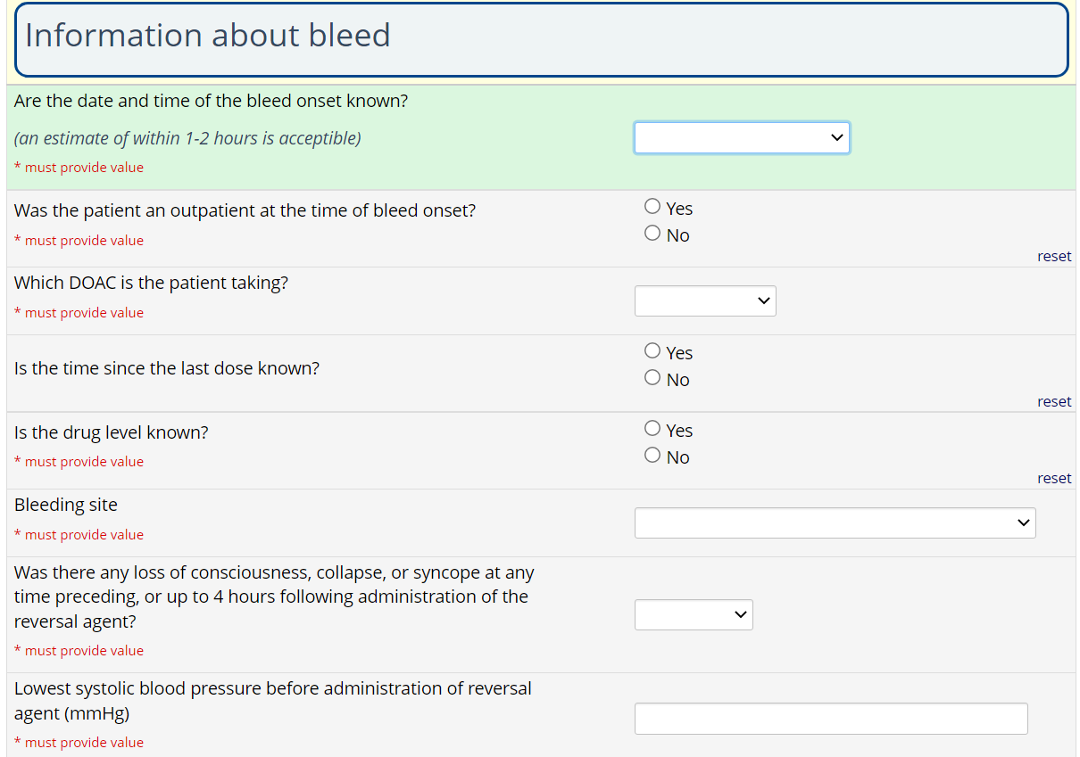
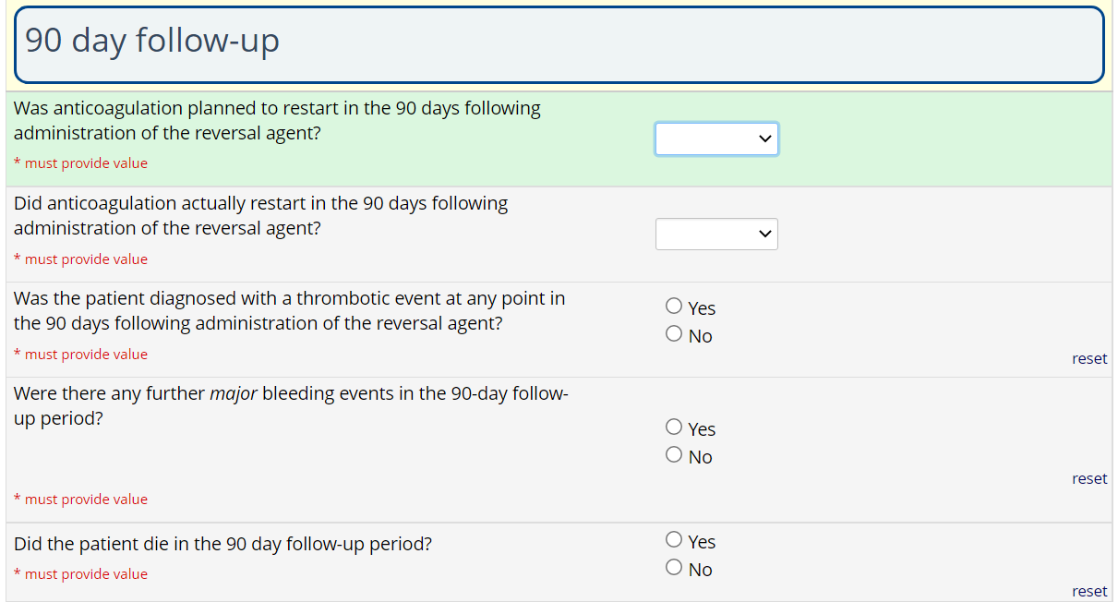
Data collection
Split across three ‘forms’
  Patient and medical history
  Bleeding episode
  Outcomes and follow-up

Slide 17
Data collection
Split across three ‘forms’
  Patient and medical history
  Bleeding episode
  Outcomes and follow-up

Slide 18
Data collection
Split across three ‘forms’
  Patient and medical history
  Bleeding episode
  Outcomes and follow-up

Slide 19
Questions richard.buka@nhs.net
MDS-c-BiCOPS@adf.bham.ac.uk
@HaemSTAR_UK www.haemstar.org/RAPIDO

